Slide 1
Platooning using TORCS
Feiyang Cai, Shreyas Ramakrishna
&
Bradley Potteiger

Slide 2
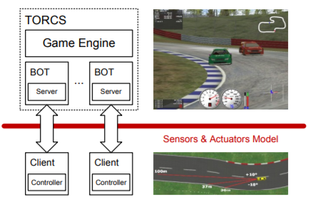
TORCS Architecture*
The multi-car implementation uses the TORCS game engine, but has one server for each client.
Each server sends sensory information and waits (blocks) 10ms (real-time) for an action.
Every game tic (20ms simulated time), the server sends the race state to the clients.
*Ref [1]

Slide 3
Setup
Two car platooning using TORCS.
The follower car tries to follows the leader car with a minimum specified distance.
First car: The car follows the track angle and vehicle position to control the steering, and moves forward. (reference [2])
Second car: The control is taken car in multipart's.
Controls the acceleration and brakes (depends on the leader car)
Controls the steering movements (depends on the side wall distance)

Slide 4
Goal of the Car’s
Leader Car:
Try to maintain a uniform speed (60-70km/hr) (target speed in our case 60 km/hr)
Follower Car:
Follow the Leader car. (do not go ahead/ lag too much)
Try to maintain the speed limits of 70km/hr.
Maintain a minimum desirable distance from the leader Car. Here the minimum distance is 20m.

Slide 5
Sensor’s used
Name | Range | Description
Angle | [-π, +π] radians | Angle between car direction and the direction of track axis
Lidar1 | [0,200] meters | Vector of 36 opponent sensor, each covering a span of 10 degrees within 200m and returns the distance of the closest car. The 36 sensors span over from -180 degrees to 180 degrees.
speedX | [-∞, +∞ ] km/hr | Speed of the car along longitudinal axis of the car
speedY | [-∞, +∞ ] km/hr | Speed of the car along transverse axis of the car
Lidar2 | [0, 200] meters | Vector of 19 range finder sensors: each sensors returns the distance between the track edge and the car within range of 200m. Sensor samples the space in front of the car every 10 degree, spanning clockwise from -90 to +90 degrees.
TrackPos | [-∞, +∞ ] | Distance between the car and the track axis. The value is normalized w.r.t to the track width: -1: when car is on right edge of the track. +1: when car is on left edge of the track. 0: when car is on the track.

Slide 6
Actuators used
Name | Range | Description
accel | [0,1] | acceleration
brake | [0,1] | braking
steering | [-1,1] | Steering: -1-Right +1-Left
gear | -1,0,1,2,3,4,5,6 | Different available gears, varies with speed

Slide 7
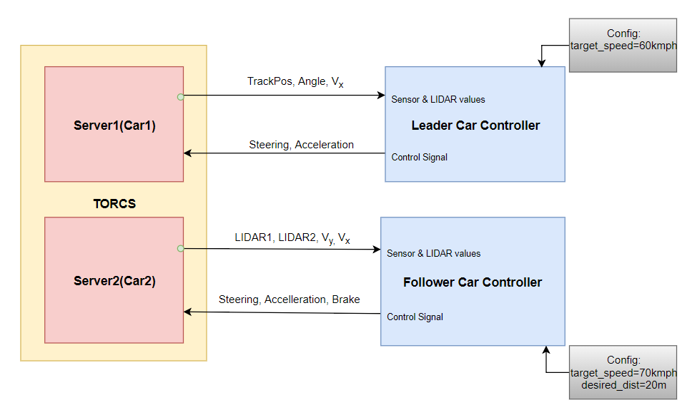
Controller Implementation
Sensor | Description
LIDAR1 | Measures distance from the leader car
LIDAR2 | Measures distance between car and track sidewall
TrackPos | Distance between car and track axis
Angle | Angle between car direction and track
SpeedX(Vx) | Speed along longitudinal axis
SpeedY(Vy) | Speed along transverse axis

Slide 8
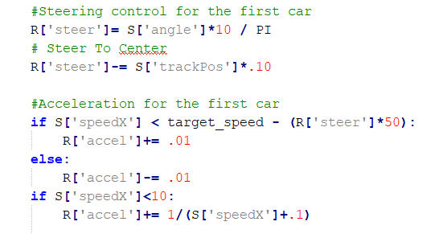
Leader Car Controller
Steering Control calculated using TrackPos and Angle.
TrackPos: Distance between the car and track axis.
Angle: The angle between the car direction and direction of track axis.
The acceleration is changed based on the current car speed.
The simple controller tries to keep the car within the track.

Slide 9
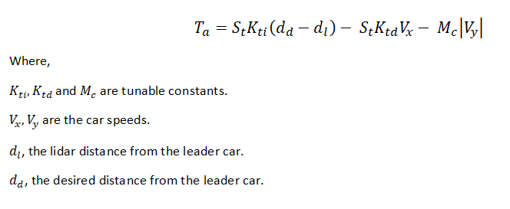
Follower Car Controller
Based on the equations taken from [1].
Acceleration:

Slide 10
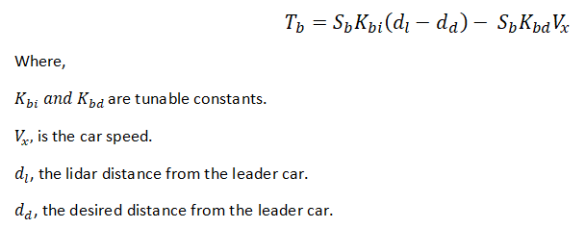
Follower Car Controller
Based on the equations taken from [1].
Braking:

Slide 11
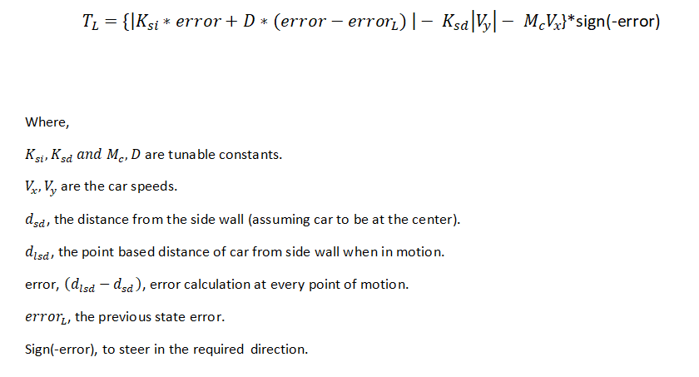
Follower Car Controller
Based on the equations taken from [1].
Steering:

Slide 12
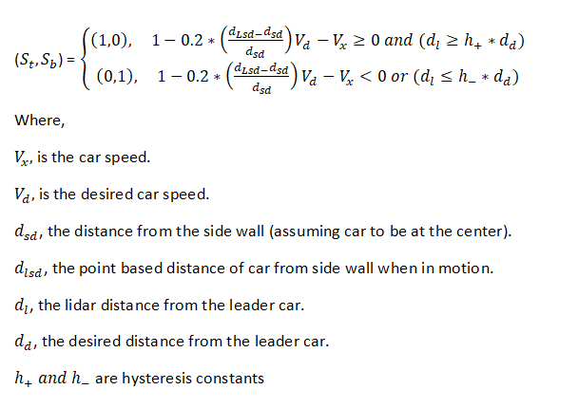
Follower Car Controller
Based on the equations taken from [1].
Guard conditions for acceleration and braking:

Slide 13
Monitoring Data
InfluxDB: Data store for large amount of time stamped sensor data.
Continuous queries and flexible Retention policies.
InfluxQL similar to SQL query language.
Open Source, handles high data ingest and real time querying of sensor data.
Grafana: Open tool platform for analytic and monitoring data.
Built in InfluxDB support.
A dashboard with rich query support for plotting graphs.
Simple query for users to get a graphical look at the sensor data.

Slide 14
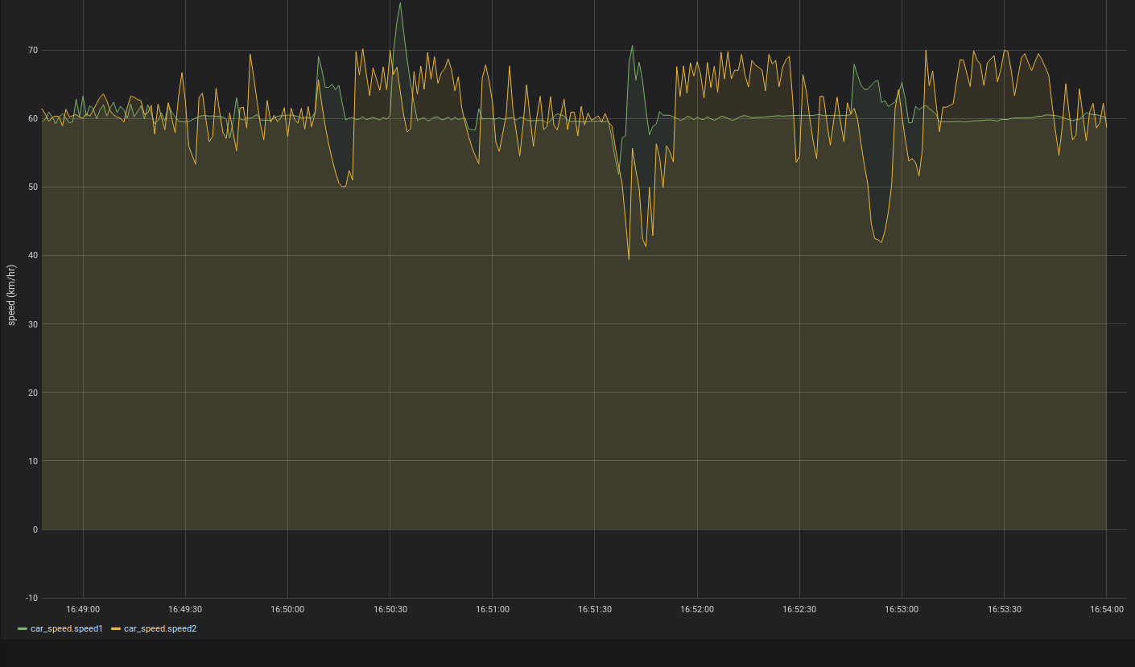
Speed comparison
Speed limit: Speed of Car2 fluctuates around 60-70Km/hr, to maintain its distance.

Slide 15
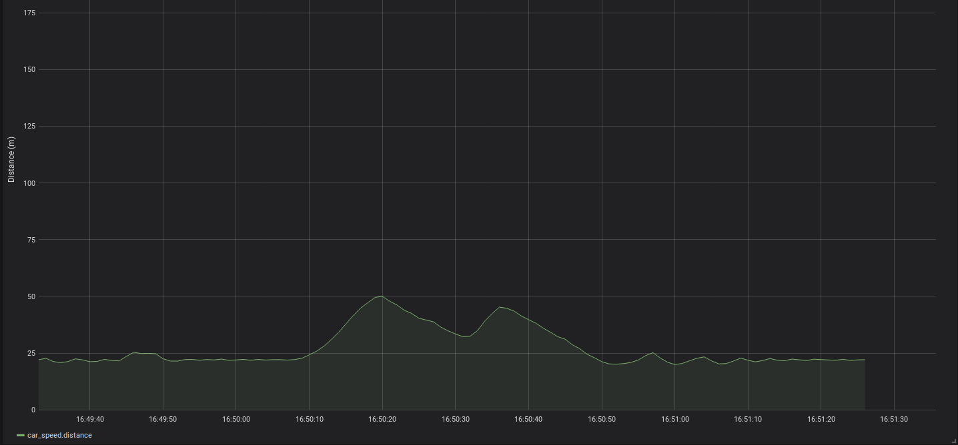
Distance maintained by Car2
Desired value: 20m, however fluctuates between 20- 24 most of the times.
Except for sharp turns, where distance increases due to deceleration and braking.

Slide 16
Controller Demo
Please find the video at:
https://drive.google.com/open?id=14MiOXXF6OSJDvI1Ov1VHnVlcsncwZW13

Slide 17
References
[1] S. Dai X. Koutsoukos "Safety analysis of automotive control systems using multi-modal port-hamiltonian systems" Proc. 19th Int. Conf. Hybrid Syst. Comput. Control pp. 105-114 2016.
[2] https://github.com/ugo-nama-kun/gym_torcs
[3] Simulated Car Racing Championship Competition Software Manual, Politecnico di Milano, Dipartimento di Elettronica, Informazione e Biogegneria, Italy

